Slide 1
The Evolution and Architecture of Modern Computers
Professor Ken Birman
CS4414 Lecture 2

Slide 2
Idea Map for today
Computers are multicore NUMA machines capable of many forms of parallelism. They are extremely complex and sophisticated.
Individual CPUs don’t make this NUMA dimension obvious. The whole idea is that if you don’t want to know, you can ignore the presence of parallelism
Compiled languages are translated to machine language. Understanding this mapping will allow us to make far more effective use of the machine.

Slide 3
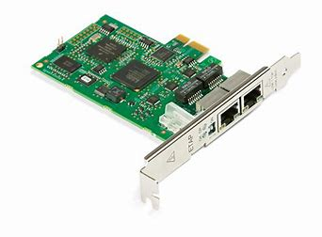
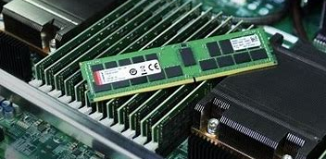
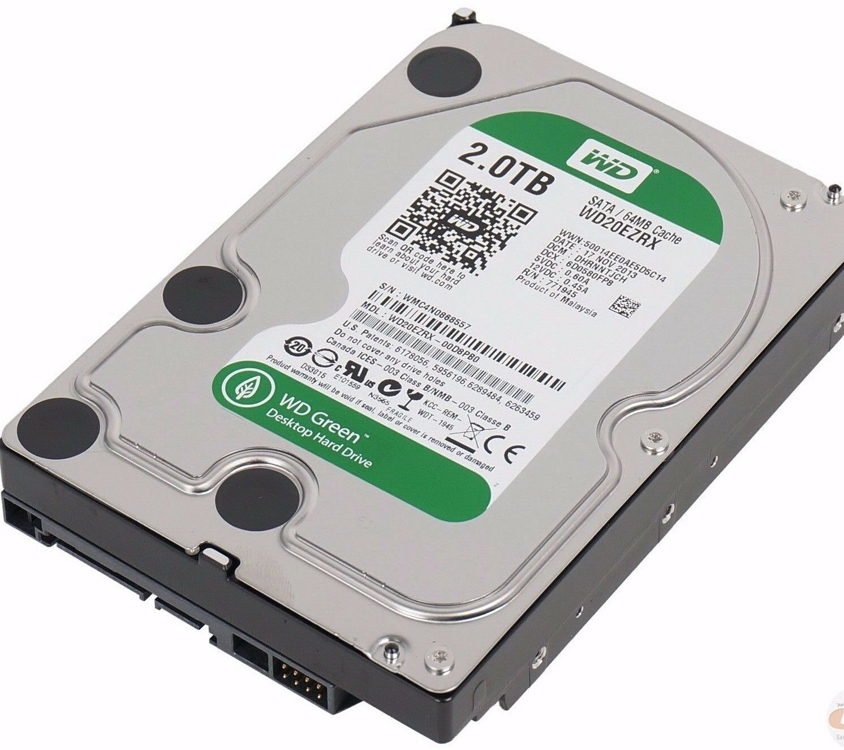
What’s Inside? Architecture = components of a computer + operating System
CPU
Registers (L1 cache)
CPU
Registers (L1 cache)
L2 Cache
L2 Cache
A BIG PILE OF HARDWARE REQUIRING A LOT OF HIGHLY SKILLED CARE AND FEEDING!
Core
L3 Cache
Core
Memory Bus
Memory Unit (DRAM)
SSD storage
100G Ethernet
PCIe Bus

Slide 4
What’s Inside? Architecture = components of a computer + operating System
CPU
Registers (L1 cache)
CPU
Registers (L1 cache)
L2 Cache
L2 Cache
Core
L3 Cache
Core
Memory Bus
Memory Unit (DRAM)
SSD storage
100G Ethernet
PCIe Bus

Slide 5
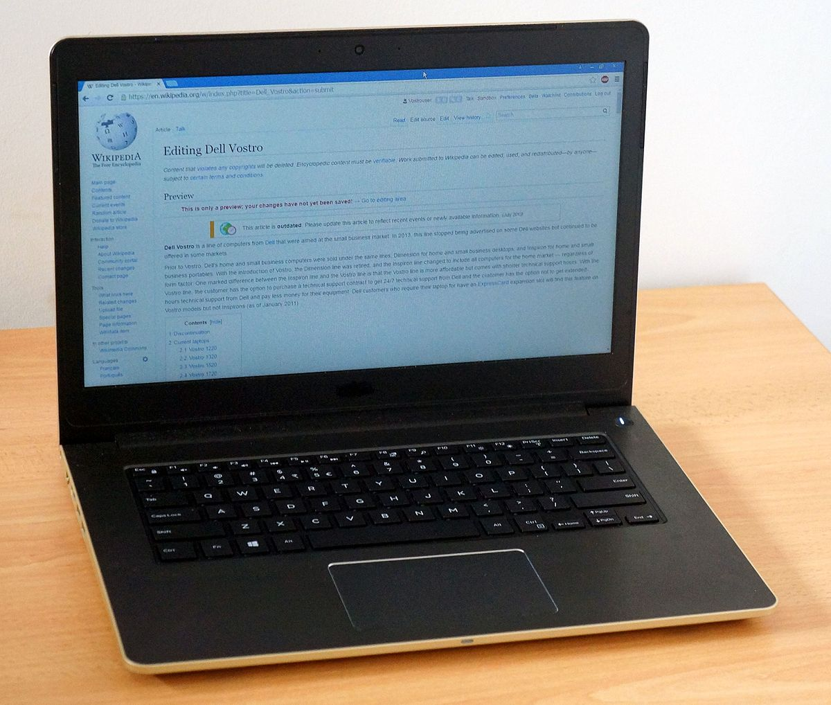
What’s Inside? Architecture = components of a computer + operating System
Job of the operating system (e.g. Linux) is to manage the hardware and offer easily used, efficient abstractions that hide details where feasible
Operating System
File System
Network
Process you launched by running some program
Bash shell

Slide 6
Architectures are changing rapidly!
As an undergraduate (in the late 1970’s) I programmed a DEC PDP 11/70 computer:
A CPU (~1/2 MIPS), main memory (4MB)
A storage device (8MB rotational magnetic disk), tape drive
I/O devices (mostly a keyboard with a printer).
At that time this cost about $100,000

Slide 7
Architectures are changing rapidly!
Bill Gates: “640K ought to be enough for anybody.”
As an undergraduate (in the late 1970’s) I programmed a DEC PDP 11/70 computer:
A CPU (~1/2 MIPS), main memory (4MB)
A storage device (8MB rotational magnetic disk), tape drive
I/O devices (mostly a keyboard with a printer).
At that time this cost about $100,000

Slide 8
Today: Machine Programming I: Basics
History of Intel processors and architectures
Assembly Basics: Registers, operands, move
Arithmetic & logical operations
C/C++, assembly, machine code

Slide 9
Modern Computer: Dell R-740: $2,600
2 Intel Xenon chips with 28 “hyperthreaded” cores running at 1GIPS (clock rate is 3Ghz)
Up to 3 TB of memory, multiple levels of memory caches
All sorts of devices accessible directly or over the network
NVIDIA Tesla T4 GPU: adds $6,000, peaks at 269 TFLOPS

Slide 10
Modern Computer: Dell R-740: $2,600
One CPU core actually runs two programs at the same time
2 Intel Xenon chips with 28 “hyperthreaded” cores running at 1GIPS (clock rate is 3Ghz)
Up to 3 TB of memory, multiple levels of memory caches
All sorts of devices accessible directly or over the network
NVIDIA Tesla T4 GPU: adds $6,000, peaks at 269 TFLOPS

Slide 11
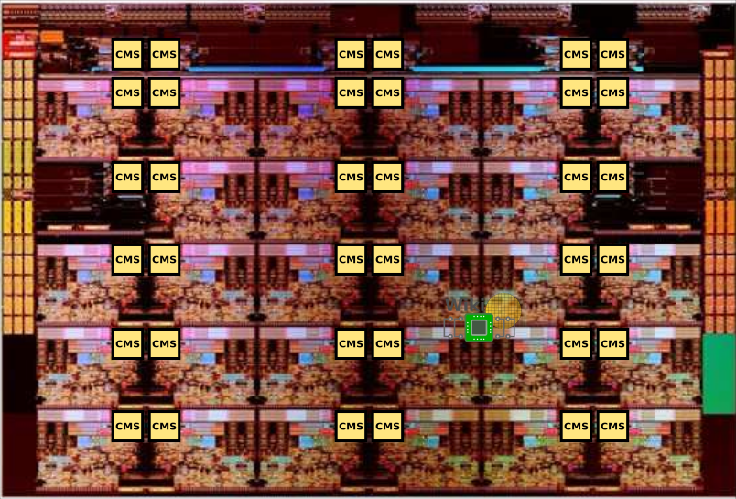
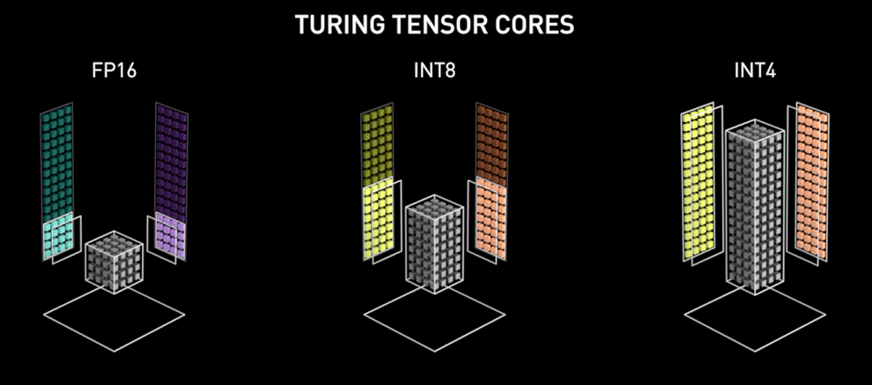
Intel Xenon NVIDIA TESLA
The GPU has so many cores that a photo of the chip is pointless. Instead they draw graphics like these to help you visualize ways of using hundreds of cores to process a tensor (the “block” in the middle) in parallel!
Each core is like a little computer, talking to the others over an on-chip network (the CMS)

Slide 12

How did we get here?
In the early years of computing, we went from machines built from distinct electronic components (earliest generations) to ones built from integrated circuits with everything on one chip.
Quickly, people noticed that each new generation of computer had roughly double the capacity of the previous one and could run roughly twice as fast! Gordon Moore proposed this as a “law”.

Slide 13
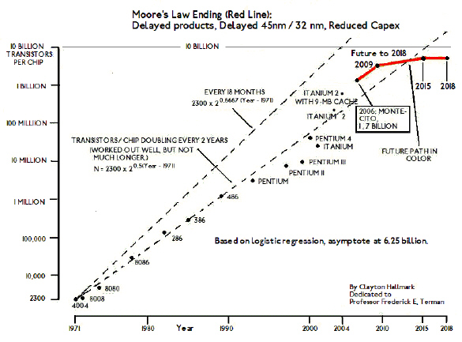
But by 2006 Moore’s Law seemed to be ending

Slide 14
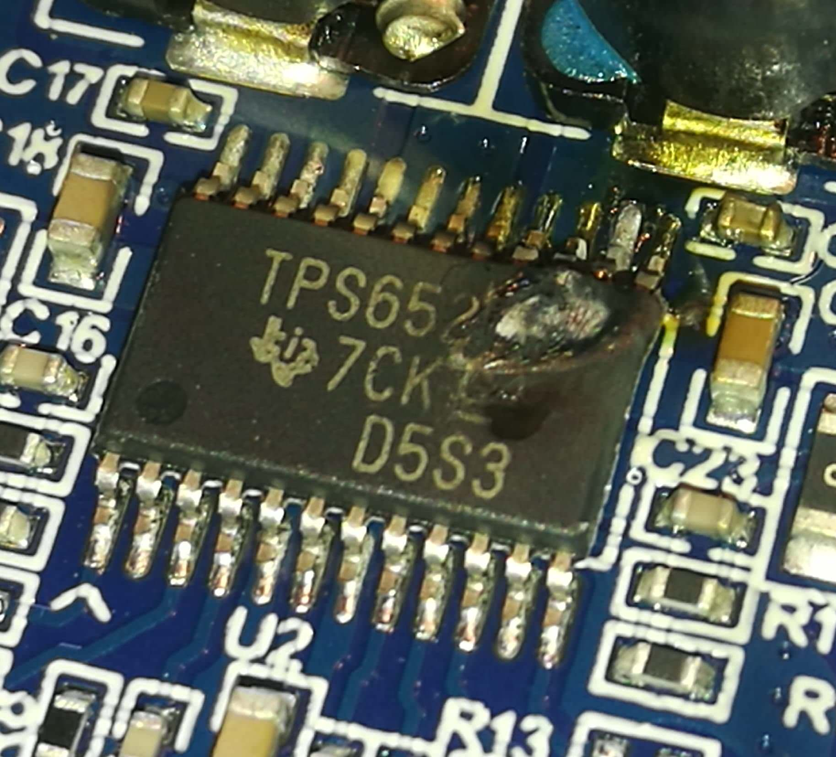
What ended Moore’s Law?
To run a chip at higher and higher speeds, we use a faster clock rate and keep more of the circuitry busy.
Computing is a form of “work” and work generates heat… as roughly the square of the clock rate.
Chips began to fail. Some would (literally) melt or catch fire!
If you overclock your desktop this can happen…

Slide 15
But parallelism saved us!
A new generation of computers emerged in which we ran the clocks at a somewhat lower speed (usually around 2 GHz, which corresponds to about 1 billion instructions per second), but had many CPUs in each computer.
A computer needs to have nearby memory, but applications needed access to “all” the memory. This leads to what we call a “non-uniform memory access behavior”: NUMA.

Slide 16
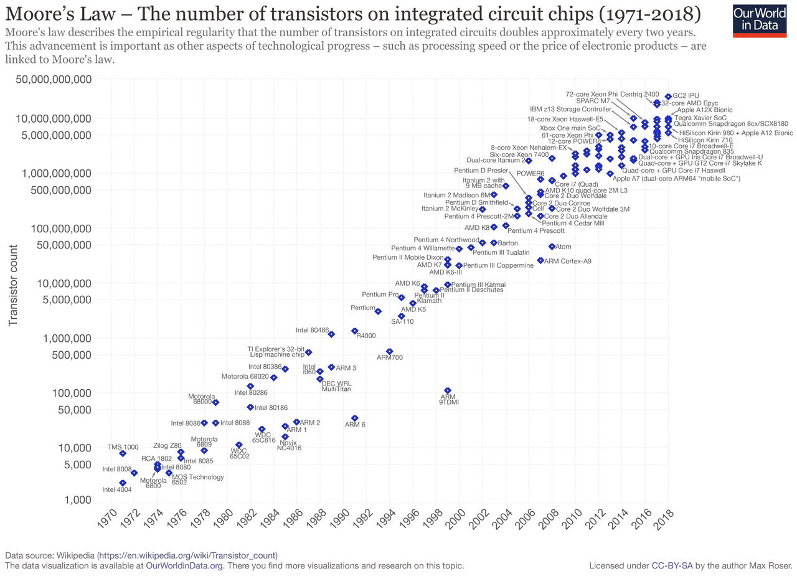
Moore’s Law with NUMA
Graph from prior slide

Slide 17
… making modern machines complicated!
Prior to 2006, a good program
Used the best algorithm: computational complexity, elegance
Implemented it in a language like C++ that offers efficiency
Ran on one machine
But the past decade has been disruptive! Suddenly even a single computer might have the ability to do hundreds of parallel tasks!

Slide 18

The Hardware shapes the Application Design process
We need to ask how a NUMA architecture impacts our designs.
If not all variables are equally fast to access, how can we “code” to achieve the fastest solution?
And how do we keep all of this hardware “optimally busy”?

Slide 19
Definitions of terms we often use
Architecture: (also ISA: instruction set architecture) The parts of a processor design that one needs to understand for writing correct machine/assembly code
Examples: instruction set specification, registers
Machine Code: Byte-level programs a processor executes
Assembly Code: Readable text representation of machine code

Slide 20
Definitions of terms we often use
Microarchitecture: “drill down”.
Details or implementation of the architecture
Examples: memory or cache sizes, clock speed (frequency)
Example ISAs:
Intel: x86, IA32, Itanium, x86-64
ARM: Used in almost all mobile phones
RISC V: New open-source ISA

Slide 21
Today: Machine Programming I: Basics
History of Intel processors and architectures
Assembly Basics: Registers, operands, move
Arithmetic & logical operations
C/C++, assembly, machine code

Slide 22
How a single thread computes
Common way to depict a single thread
In CS4414 we think of each computation in terms of a “thread”
A thread is a pointer into the program instructions. The CPU loads the instruction that the “PC” points to, fetches any operands from memory, does the action, saves the results back to memory.
Then the PC is incremented to point to the next instruction

Slide 23
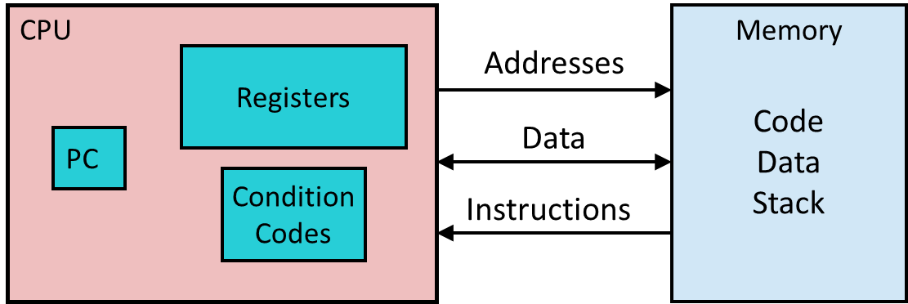
Assembly/Machine Code View
Programmer-Visible State
PC: Program counter
Address of next instruction
Called “RIP” (x86-64)
Register file
Heavily used program data
Condition codes
Store status information about most recent arithmetic or logical operation
Used for conditional branching
Memory
Byte addressable array
Code and user data
Stack to support procedures
Puzzle:
On a NUMA machine, a CPU is near a fast memory but can access all memory.
How does this impact software design?

Slide 24
Assembly/Machine Code View
Example: With 6 on-board DRAM modules and 12 NUMA CPUs, each pair of CPUs has one nearby DRAM module. Memory in that range of addresses will be very fast. The other 5 DRAM modules are further away. Data in those address ranges is visible and everything looks identical, but access is slower!
This memory is slower to access!
Programmer-Visible State
PC: Program counter
Address of next instruction
Called “RIP” (x86-64)
Register file
Heavily used program data
Condition codes
Store status information about most recent arithmetic or logical operation
Used for conditional branching
Memory
Byte addressable array
Code and user data
Stack to support procedures
Puzzle:
On a NUMA machine, a CPU is near a fast memory but can access all memory.
How does this impact software design?
Same with this one…
…
…
…

Slide 25
Linux tries to hide memory delays
If it runs thread t on core k, Linux tries to allocate memory for t (stack, malloc…) in the DRAM close to that k.
Yet all memory operations work identically even if the thread is actually accessing some other DRAM. They are just slower.
Linux doesn’t even tell you which parts of your address space are mapped to which DRAM units.

Slide 26
The hardware understands “primitive” data types
“Integer” data of 1, 2, 4, or 8 bytes
Data values
Addresses (untyped pointers)
Floating point data of 4, 8, or 10 bytes (new: 4-bit, 8-bit, 16-bit)
Code: Byte sequences encoding series of instructions
(SIMD vector data types of 8, 16, 32 or 64 bytes)
No aggregate types such as arrays or structures
Just contiguously allocated bytes in memory
Example: Raw images are arrays in a format defined by the camera or video, such as RGB, jpeg, mpeg. The camera understands the format. The host computer the camera is attached to just sees bytes

Slide 27
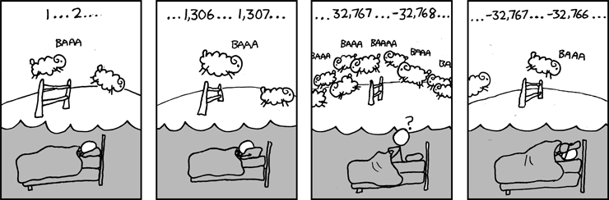
The hardware understands “primitive” data types
“Integer” data of 1, 2, 4, or 8 bytes
Data values
Addresses (untyped pointers)
Floating point data of 4, 8, or 10 bytes (new: 4-bit, 8-bit, 16-bit)
Code: Byte sequences encoding series of instructions
(SIMD vector data types of 8, 16, 32 or 64 bytes)
No aggregate types such as arrays or structures
Just contiguously allocated bytes in memory
Example: Raw images are arrays in a format defined by the camera or video, such as RGB, jpeg, mpeg. The camera understands the format. The host computer the camera is attached to just sees bytes

Slide 28
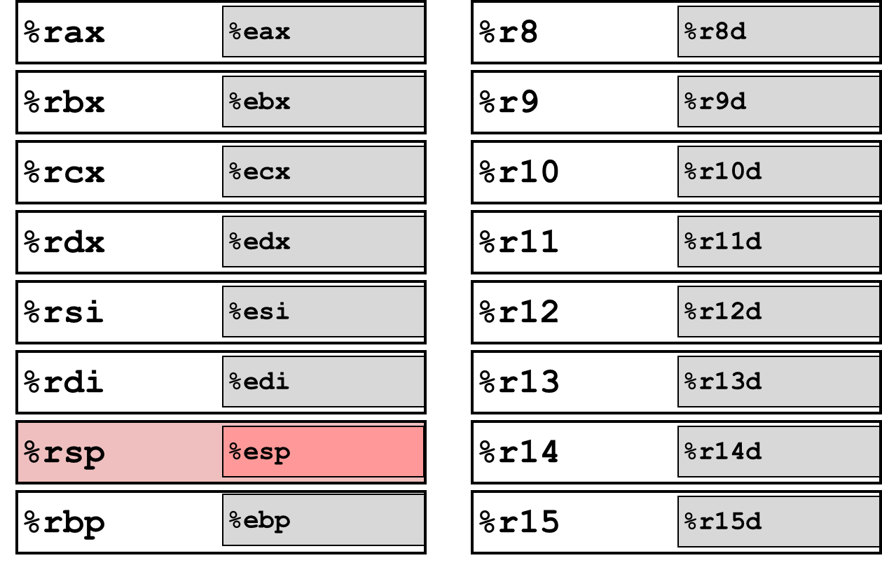
x86-64 Integer Registers
Can reference low-order 4 bytes (also low-order 1 & 2 bytes)
Not part of memory (or cache)

Slide 29
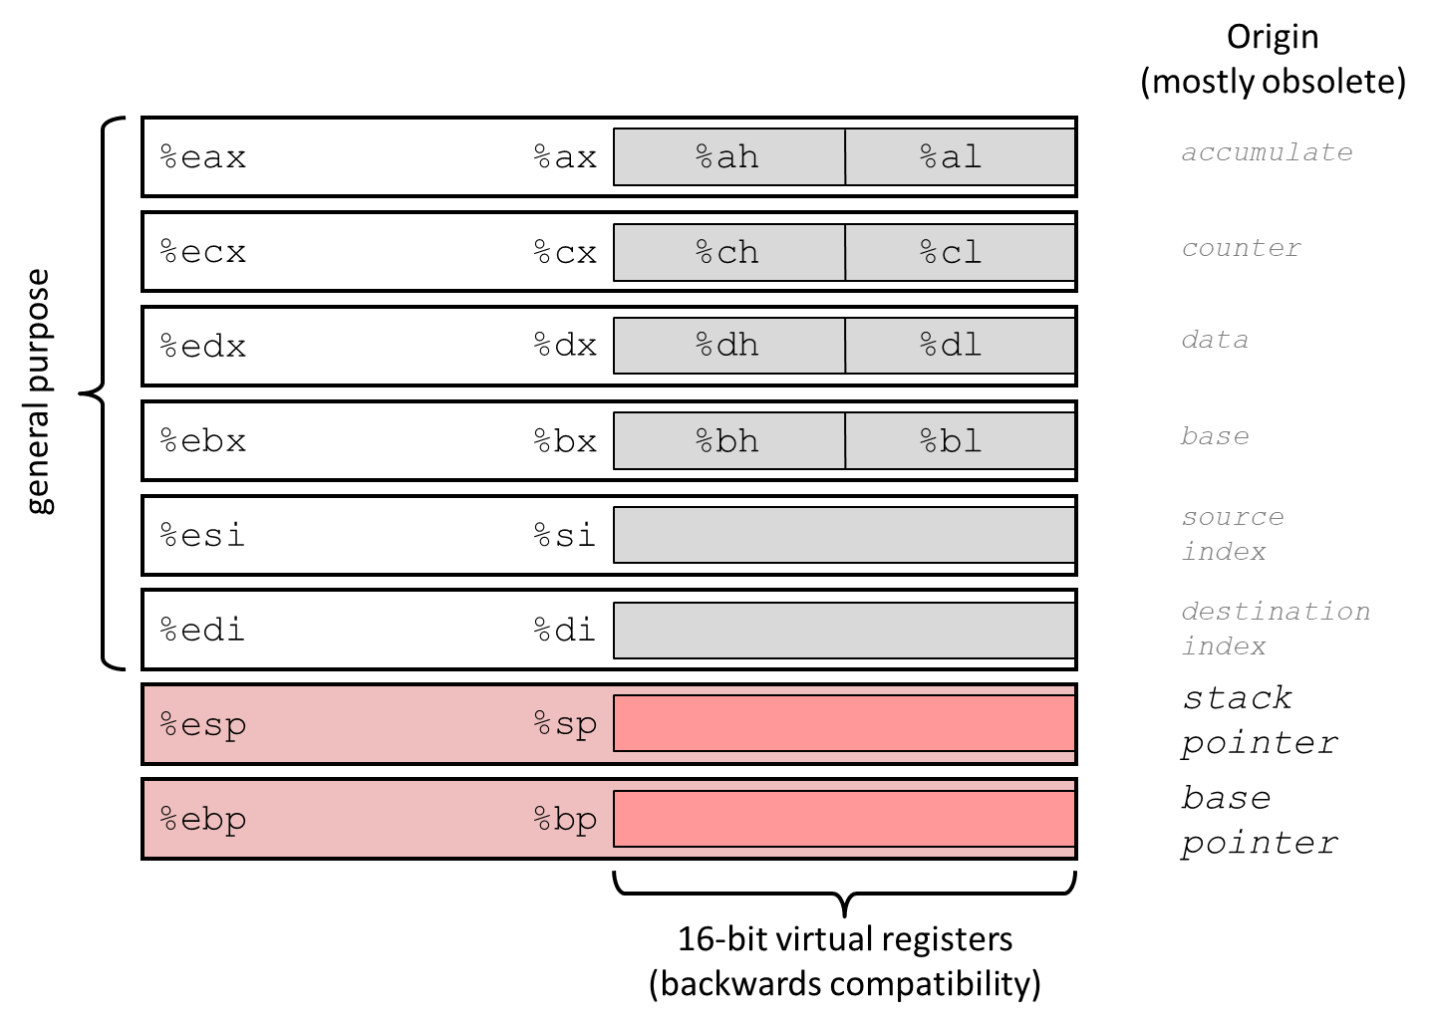
Some History: IA32 Registers

Slide 30
Assembly Characteristics: Operations
Transfer data between memory and register
Load data from memory into register
Store register data into memory
Perform arithmetic function on register or memory data
Transfer control
Unconditional jumps to/from procedures
Conditional branches
Indirect branches

Slide 31
Moving Data
%rax
%rcx
Moving Data
movq Source, Dest
Operand Types
Immediate: Constant integer data
Example: $0x400, $-533
Like C constant, but prefixed with ‘$’
Encoded with 1, 2, or 4 bytes
Register: One of 16 integer registers
Example: %rax, %r13
But %rsp reserved for special use
Others have special uses for particular instructions
Memory: 8 consecutive bytes of memory at address given by register
Simplest example: (%rax)
Various other “addressing modes”
%rdx
%rbx
%rsi
%rdi
%rsp
%rbp
%rN
Warning: Intel docs use mov Dest, Source

Slide 32
movq Operand Combinations
Source
Dest
Src,Dest
C/C++ Analog
Reg
movq $0x4,%rax
temp = 0x4;
Imm
Mem
movq $-147,(%rax)
*p = -147;
Reg
movq %rax,%rdx
temp2 = temp1;
movq
Reg
Mem
movq %rax,(%rdx)
*p = temp;
Mem
Reg
movq (%rax),%rdx
temp = *p;
Cannot do memory-memory transfer with a single instruction

Slide 33
Simple Memory Addressing Modes
Normal (R) Mem[Reg[R]]
Register R specifies memory address
Aha! Pointer dereferencing in C movq (%rcx),%rax
Displacement D(R) Mem[Reg[R]+D]
Register R specifies start of memory region
Constant displacement D specifies offset movq 8(%rbp),%rdx

Slide 34
Example of Simple Addressing Modes
void
whatAmI(<type> a, <type> b)
{
????
}
whatAmI:
movq (%rdi), %rax
movq (%rsi), %rdx
movq %rdx, (%rdi)
movq %rax, (%rsi)
ret
%rsi
%rdi

Slide 35
Example of Simple Addressing Modes
void swap
(long *xp, long *yp)
{
long t0 = *xp;
long t1 = *yp;
*xp = t1;
*yp = t0;
}
swap:
movq (%rdi), %rax
movq (%rsi), %rdx
movq %rdx, (%rdi)
movq %rax, (%rsi)
ret

Slide 36
Understanding swap()
Memory
Addr
void swap
(long *xp, long *yp)
{
long t0 = *xp;
long t1 = *yp;
*xp = t1;
*yp = t0;
}
Registers
xp
%rdi
%rsi
%rax
yp
%rdx
Register Value
%rdi xp
%rsi yp
%rax t0
%rdx t1
swap:
movq (%rdi), %rax # t0 = *xp
movq (%rsi), %rdx # t1 = *yp
movq %rdx, (%rdi) # *xp = t1
movq %rax, (%rsi) # *yp = t0
ret

Slide 37
Understanding swap()
Memory
Registers
Address
123
0x120
%rdi
0x120
0x118
%rsi
0x100
0x110
%rax
0x108
%rdx
456
0x100
swap:
movq (%rdi), %rax # t0 = *xp
movq (%rsi), %rdx # t1 = *yp
movq %rdx, (%rdi) # *xp = t1
movq %rax, (%rsi) # *yp = t0
ret

Slide 38
Understanding swap()
Memory
Registers
Address
123
0x120
%rdi
0x120
0x118
%rsi
0x100
0x110
%rax
123
0x108
%rdx
456
0x100
swap:
movq (%rdi), %rax # t0 = *xp
movq (%rsi), %rdx # t1 = *yp
movq %rdx, (%rdi) # *xp = t1
movq %rax, (%rsi) # *yp = t0
ret

Slide 39
Understanding swap()
Memory
Registers
Address
123
0x120
%rdi
0x120
0x118
%rsi
0x100
0x110
%rax
123
0x108
%rdx
456
456
0x100
swap:
movq (%rdi), %rax # t0 = *xp
movq (%rsi), %rdx # t1 = *yp
movq %rdx, (%rdi) # *xp = t1
movq %rax, (%rsi) # *yp = t0
ret

Slide 40
Understanding swap()
Memory
Registers
Address
456
0x120
%rdi
0x120
0x118
%rsi
0x100
0x110
%rax
123
0x108
%rdx
456
456
0x100
swap:
movq (%rdi), %rax # t0 = *xp
movq (%rsi), %rdx # t1 = *yp
movq %rdx, (%rdi) # *xp = t1
movq %rax, (%rsi) # *yp = t0
ret

Slide 41
Understanding swap()
Memory
Registers
Address
456
0x120
%rdi
0x120
0x118
%rsi
0x100
0x110
%rax
123
0x108
%rdx
456
123
0x100
swap:
movq (%rdi), %rax # t0 = *xp
movq (%rsi), %rdx # t1 = *yp
movq %rdx, (%rdi) # *xp = t1
movq %rax, (%rsi) # *yp = t0
ret

Slide 42
Simple Memory Addressing Modes
Normal (R) Mem[Reg[R]]
Register R specifies memory address
Aha! Pointer dereferencing in C movq (%rcx),%rax
Displacement D(R) Mem[Reg[R]+D]
Register R specifies start of memory region
Constant displacement D specifies offset movq 8(%rbp),%rdx

Slide 43
Complete Memory Addressing Modes
Most General Form
D(Rb,Ri,S) Mem[Reg[Rb]+S*Reg[Ri]+ D]
D: Constant “displacement” 1, 2, or 4 bytes
Rb: Base register: Any of 16 integer registers
Ri: Index register: Any, except for %rsp
S: Scale: 1, 2, 4, or 8 (why these numbers?)
Special Cases
(Rb,Ri) Mem[Reg[Rb]+Reg[Ri]]
D(Rb,Ri) Mem[Reg[Rb]+Reg[Ri]+D]
(Rb,Ri,S) Mem[Reg[Rb]+S*Reg[Ri]]

Slide 44
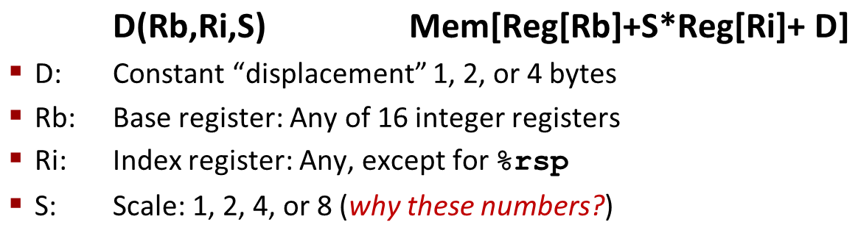
Address Computation Examples
%rdx | 0xf000
%rcx | 0x0100
Expression | Address Computation | Address
0x8(%rdx)
(%rdx,%rcx)
(%rdx,%rcx,4)
0x80(,%rdx,2)
Expression | Address Computation | Address
0x8(%rdx) | 0xf000 + 0x8 | 0xf008
(%rdx,%rcx) | 0xf000 + 0x100 | 0xf100
(%rdx,%rcx,4) | 0xf000 + 4*0x100 | 0xf400
0x80(,%rdx,2) | 2*0xf000 + 0x80 | 0x1e080
Notes:
0xf000 + 0x8 = 0xf008
0xf000 + 0x0100 = 0xf100
0xf000 + 4*0x0100 = 0xf400
2*0xf000 + 0x80 = 0x1d080

Slide 45
Address Computation Examples
%rdx | 0xf000
%rcx | 0x0100
Expression | Address Computation | Address
0x8(%rdx)
(%rdx,%rcx)
(%rdx,%rcx,4)
0x80(,%rdx,2)
Expression | Address Computation | Address
0x8(%rdx) | 0xf000 + 0x8 | 0xf008
(%rdx,%rcx) | 0xf000 + 0x100 | 0xf100
(%rdx,%rcx,4) | 0xf000 + 4*0x100 | 0xf400
0x80(,%rdx,2) | 2*0xf000 + 0x80 | 0x1e080
Notes:
0xf000 + 0x8 = 0xf008
0xf000 + 0x0100 = 0xf100
0xf000 + 4*0x0100 = 0xf400
2*0xf000 + 0x80 = 0x1d080

Slide 46
Today: Machine Programming I: Basics
History of Intel processors and architectures
Assembly Basics: Registers, operands, move
Arithmetic & logical operations
C/C++, assembly, machine code

Slide 47
Address Computation Instruction
leaq Src, Dst
Src is address mode expression
Set Dst to address denoted by expression
Uses
Computing addresses without a memory reference
E.g., translation of p = &x[i];
Computing arithmetic expressions of the form x + k*y
k = 1, 2, 4, or 8
Example
long m12(long x)
{
return x*12;
}
Converted to ASM by compiler:
leaq (%rdi,%rdi,2), %rax # t = x+2*x
salq $2, %rax # return t<<2

Slide 48
Some Arithmetic Operations
Two Operand Instructions:
Format Computation
addq Src,Dest Dest = Dest + Src
subq Src,Dest Dest = Dest − Src
imulq Src,Dest Dest = Dest * Src
shlq Src,Dest Dest = Dest << Src Synonym: salq
sarq Src,Dest Dest = Dest >> Src Arithmetic
shrq Src,Dest Dest = Dest >> Src Logical
xorq Src,Dest Dest = Dest ^ Src
andq Src,Dest Dest = Dest & Src
orq Src,Dest Dest = Dest | Src
Watch out for argument order! Src,Dest (Warning: very old Intel docs use “op Dest,Src”)
No distinction between signed and unsigned int (why?)

Slide 49
Some Arithmetic Operations
One Operand Instructions
incq Dest Dest = Dest + 1
decq Dest Dest = Dest − 1
negq Dest Dest = − Dest
notq Dest Dest = ~Dest
See book for more instructions
Depending how you count, there are 2,034 total x86 instructions
(If you count all addr modes, op widths, flags, it’s actually 3,683)

Slide 50
Arithmetic Expression Example
arith:
leaq (%rdi,%rsi), %rax
addq %rdx, %rax
leaq (%rsi,%rsi,2), %rdx
salq $4, %rdx
leaq 4(%rdi,%rdx), %rcx
imulq %rcx, %rax
ret
long arith
(long x, long y, long z)
{
long t1 = x+y;
long t2 = z+t1;
long t3 = x+4;
long t4 = y * 48;
long t5 = t3 + t4;
long rval = t2 * t5;
return rval;
}
Interesting Instructions
leaq: address computation
salq: shift
imulq: multiplication
Curious: only used once…
Notes:
(rsi,rsi,2) = 3y; 3y << 4 == 3y * 16 = 48y

Slide 51
Understanding Arithmetic Expression Example
arith:
leaq (%rdi,%rsi), %rax # t1
addq %rdx, %rax # t2
leaq (%rsi,%rsi,2), %rdx
salq $4, %rdx # t4
leaq 4(%rdi,%rdx), %rcx # t5
imulq %rcx, %rax # rval
ret
long arith
(long x, long y, long z)
{
long t1 = x+y;
long t2 = z+t1;
long t3 = x+4;
long t4 = y * 48;
long t5 = t3 + t4;
long rval = t2 * t5;
return rval;
}
Register | Use(s)
%rdi | Argument x
%rsi | Argument y
%rdx | Argument z, t4
%rax | t1, t2, rval
%rcx | t5

Slide 52
Evolution of Intel Instruction Set
The Intel instruction set has changed over the decades since it was first introduced.
Intel is a believer in the “CISC” model: complex instructions that are highly optimized
Modern example: vector parallel instructions (also called SIMD: Single instruction, multiple data). Introduced to make the x86 more competitive with GPU accelerators
Such as “Multiply these two vectors and put the result in this third vector”, or “sum up the elements in this vector, and put the result here.”
The underlying hardware uses parallel processing to do the job faster.
The C++ compiler can recognize many of these patterns and will emit vector parallel instructions (if the target computer supports them). You can also provide “hints” to the compiler, to do so.
There are many more examples; we will see a few later in the semester

Slide 53
Today: Machine Programming I: Basics
History of Intel processors and architectures
Assembly Basics: Registers, operands, move
Arithmetic & logical operations
C/C++, assembly, machine code

Slide 54
Turning C/C++ into Object Code
Code in files p1.cpp p2.c
Compile with command: c++ pp1.cpp p2.c -o p
There are often additional arguments such as –O3, -pg, -g…
Put resulting binary in file p
text
C/C++ program (p1.cpp p2.c)
Compiler (c++)
text
Asm program (p1.s p2.s)
Assembler (c++ or as)
binary
Object program (p1.o p2.o)
Static libraries (.a)
Linker (c++ or ld)
binary
Executable program (p)

Slide 55
Compiling Into Assembly
C/C++ Code (sum.c)
Generated x86-64 Assembly
long plus(long x, long y);
void sumstore(long x, long y,
long *dest)
{
long t = plus(x, y);
*dest = t;
}
sumstore:
pushq %rbx
movq %rdx, %rbx
call plus
movq %rax, (%rbx)
popq %rbx
ret
Obtain with command
C++ sum.c
Produces file sum.s
This uses the “indirect” addressing mode: dest holds a memory address and *dest is a long integer at that address. We are using that location as a variable here!

Slide 56
What it really looks like
.globl sumstore
.type sumstore, @function
sumstore:
.LFB35:
.cfi_startproc
pushq %rbx
.cfi_def_cfa_offset 16
.cfi_offset 3, -16
movq %rdx, %rbx
call plus
movq %rax, (%rbx)
popq %rbx
.cfi_def_cfa_offset 8
ret
.cfi_endproc
.LFE35:
.size sumstore, .-sumstore

Slide 57
What it really looks like
Things that look weird and are preceded by a ‘.’ are generally directives.
.globl sumstore
.type sumstore, @function
sumstore:
.LFB35:
.cfi_startproc
pushq %rbx
.cfi_def_cfa_offset 16
.cfi_offset 3, -16
movq %rdx, %rbx
call plus
movq %rax, (%rbx)
popq %rbx
.cfi_def_cfa_offset 8
ret
.cfi_endproc
.LFE35:
.size sumstore, .-sumstore
sumstore:
pushq %rbx
movq %rdx, %rbx
call plus
movq %rax, (%rbx)
popq %rbx
ret

Slide 58
Assembly Characteristics: Data Types
“Integer” data of 1, 2, 4, or 8 bytes
Data values
Addresses (untyped pointers)
Floating point data of 4, 8, or 10 bytes
(SIMD vector data types of 8, 16, 32 or 64 bytes)
Code: Byte sequences encoding series of instructions
No aggregate types such as arrays or structures
Just contiguously allocated bytes in memory

Slide 59
Assembly Characteristics: Operations
Transfer data between memory and register
Load data from memory into register
Store register data into memory
Perform arithmetic function on register or memory data
Transfer control
Unconditional jumps to/from procedures
Conditional branches

Slide 60
Object Code
Code for sumstore
Assembler
Translates .s into .o
Binary encoding of each instruction
Nearly-complete image of executable code
Missing linkages between code in different files
Linker
Resolves references between files
Combines with static run-time libraries
e.g., code for malloc, printf
Some libraries are dynamically linked
Linking occurs when program begins execution
0x0400595:
0x53
0x48
0x89
0xd3
0xe8
0xf2
0xff
0xff
0xff
0x48
0x89
0x03
0x5b
0xc3
Total of 14 bytes
Each instruction 1, 3, or 5 bytes
Starts at address 0x0400595

Slide 61
Machine Instruction Example
C Code
Store value t where designated by dest
Assembly
Move 8-byte value to memory
Quad words in x86-64 parlance
Operands:
t: Register %rax
dest: Register %rbx
*dest: Memory M[%rbx]
Object Code
3-byte instruction
Stored at address 0x40059e
*dest = t;
movq %rax, (%rbx)
0x40059e: 48 89 03

Slide 62
Disassembling Object Code
Disassembled
0000000000400595 <sumstore>:
400595: 53 push %rbx
400596: 48 89 d3 mov %rdx,%rbx
400599: e8 f2 ff ff ff callq 400590 <plus>
40059e: 48 89 03 mov %rax,(%rbx)
4005a1: 5b pop %rbx
4005a2: c3 retq
Disassembler
objdump –d sum
Useful tool for examining object code
Analyzes bit pattern of series of instructions
Produces approximate rendition of assembly code
Can be run on either a.out (complete executable) or .o file

Slide 63
Alternate Disassembly
Disassembled
Dump of assembler code for function sumstore:
0x0000000000400595 <+0>: push %rbx
0x0000000000400596 <+1>: mov %rdx,%rbx
0x0000000000400599 <+4>: callq 0x400590 <plus>
0x000000000040059e <+9>: mov %rax,(%rbx)
0x00000000004005a1 <+12>:pop %rbx
0x00000000004005a2 <+13>:retq
Within gdb Debugger
Disassemble procedure
gdb sum
disassemble sumstore

Slide 64

Warning!
Disassembly is useful when debugging but prohibited in many situations. A common and valid use is to understand what caused your own code to crash. With a complex piece of code knowing the line number isn’t always enough.
Hackers disassemble programs to look for coding errors that they can leverage to steal passwords or even take control by sending malformed inputs. This is why it is illegal to disassemble things like Microsoft Word.
Cornell has harsh penalties for people who engage in hacking activities while enrolled in the university. A hacker could be suspended or expelled!

